Slide 1
PHP Basics: Variables, Control Loops, Conditional Statements

Slide 2
What is PHP
is a widely-used open source general-purpose scripting language that is especially suited for web development and can be embedded into HTML.
A server side language that is mostly common by programmers.
Hypertext Preprocessor
Created in 1994 by Rasmus Lerdorf

Slide 3
Why PHP ?
it is a free language with no licensing fees so the cost of using it is minimal.
According to Hackermoon, 5th programming Language
Easy to learn.
PHP powers up to 200 millions websites, including wordpress, digg and facebook.
It is being used by facebook.
It is a loose languange like javascript

Slide 4
Topics
Variables
Control loops
Conditional Statements
Functions
Requiring files

Slide 5
PHP Variables
Data Types: String, Integer, Float / Double, Boolean, NULL, Array, Object
Scoping: Local, Static and Global

Slide 6
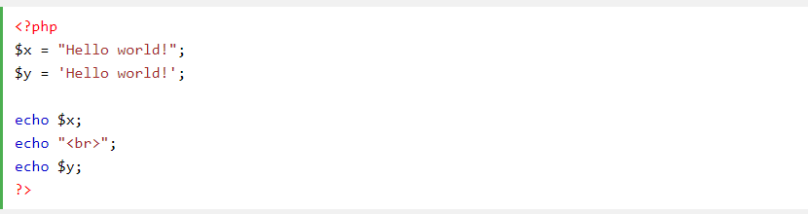
String
A string is a sequence of characters, like "Hello world!".
A string can be any text inside quotes. You can use single or double quotes

Slide 7
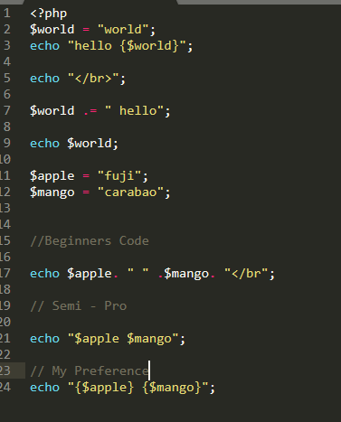
Strings also can be added inside a string.

Slide 8
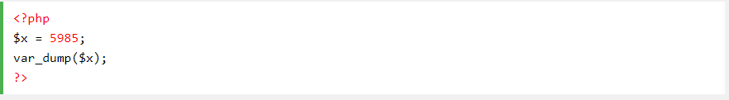
Integer
An integer must have at least one digit
An integer must not have a decimal point
An integer can be either positive or negative

Slide 9
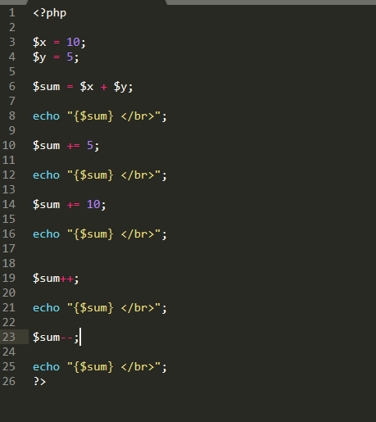

Slide 10
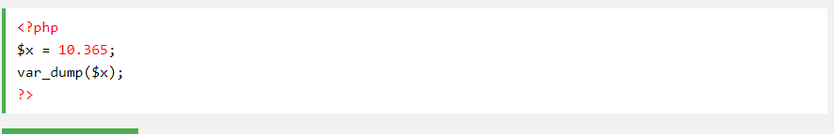
Float
a number with a decimal.

Slide 11
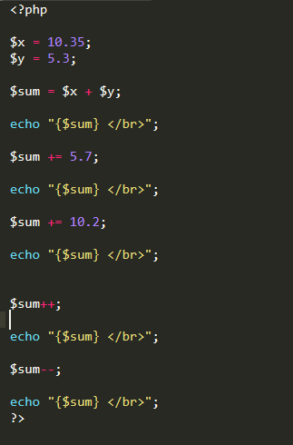

Slide 12
Why Data types?
Data types allow a compiler to allocate the right memory space for a variable, and also let it perform type checking, making sure the program uses the variables correctly per their defined type.
In a language like C, variables are statically typed. So you have types like char, short, int, float, double, and many more.
A char is the smallest addressable unit of memory that can contain one character, and is typically 8 bits in size. A short is at least 16 bits in size, and a long is at least 32-bits.

Slide 13
Boolean
represents two possible states: TRUE or FALSE.

Slide 14
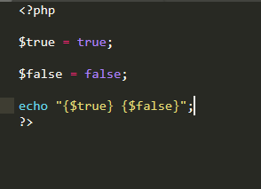

Slide 15
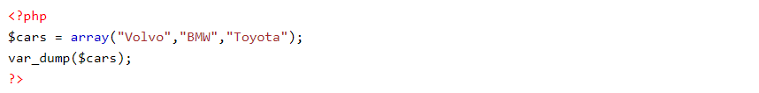
Array
An array stores multiple values in one single variable.

Slide 16
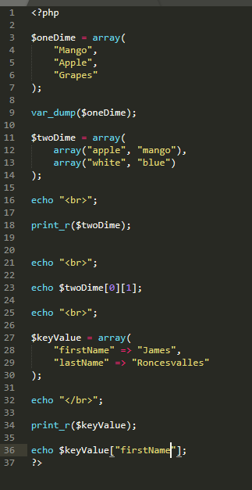

Slide 17
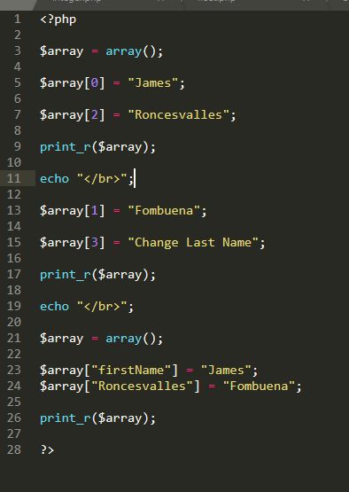

Slide 18
Exercise - 1
Declare two String variables, first name and last name;
I want you to print in one line via echo, between first name and last name is your middle name, if none, pls write your gender

Slide 19
Exercise - 2
I want you to declare two integer variables.
Get the sum, difference, division and multiplication of it. Assign each operation in a variable.
Example, sum = a + b;
Then echo it per line

Slide 20
Exercise - 3
Declare 5 float variables
Get their Average and assign it to a variable

Slide 21
Exercise 4
Declare one, two dimensional array and swap their values. Tip: you can use a third Array for placement;
Declare one, key value Array, first name and lastname, then swap their values. Print first the orignal value then after it swap, then print the output.

Slide 22
Scoping

Slide 23
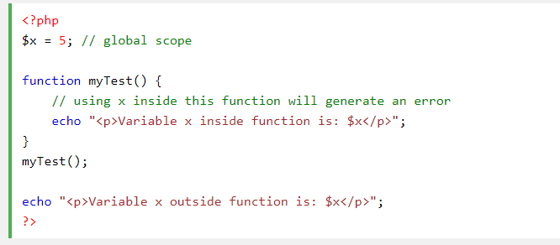
Local Scoping
A variable which is being accessed inside a function

Slide 24
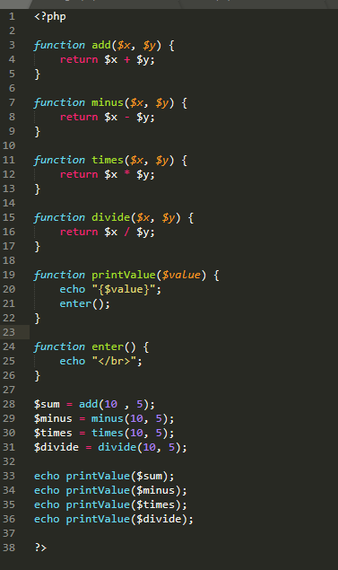

Slide 25
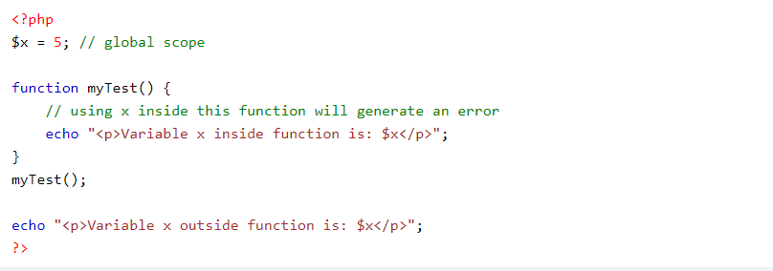
Global Scoping
A variable declared outside a function has a GLOBAL SCOPE and can only be accessed outside a function:

Slide 26
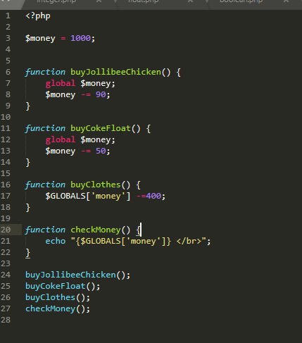

Slide 27
Static Scope
Normally, when a function is completed/executed, all of its variables are deleted. However, sometimes we want a local variable NOT to be deleted. We need it for a further job.
To do this, use the static keyword when you first declare the variable:

Slide 28
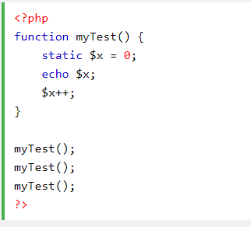

Slide 29
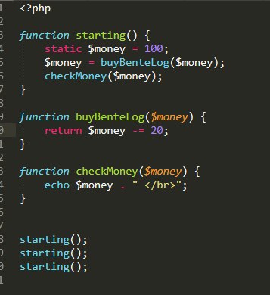

Slide 30
Exercise for Functions
Local and Global Scoping:
Declare three variables
Get their sum, difference and average
Use a function to print each results.
Static Scoping:
Declare three variables
Multiply them 2 times and print each result
Use a function to print each results.

Slide 31
Requiring files: Include and Require
require will produce a fatal error (E_COMPILE_ERROR) and stop the script
include will only produce a warning (E_WARNING) and the script will continue

Slide 32
Example
We will create a footer.php with a content of
<?php echo "<p>Copyright &copy; 1999-" . date("Y") . " W3Schools.com</p>"; ?>

Slide 33
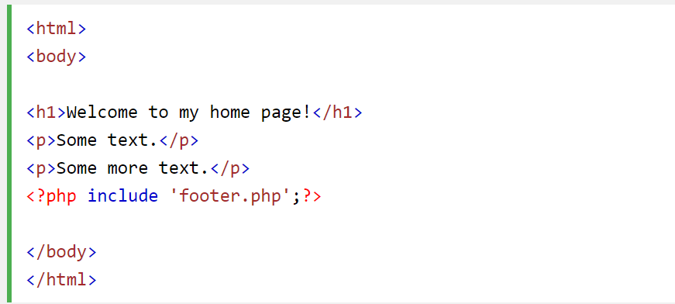
Embed in a page

Slide 34
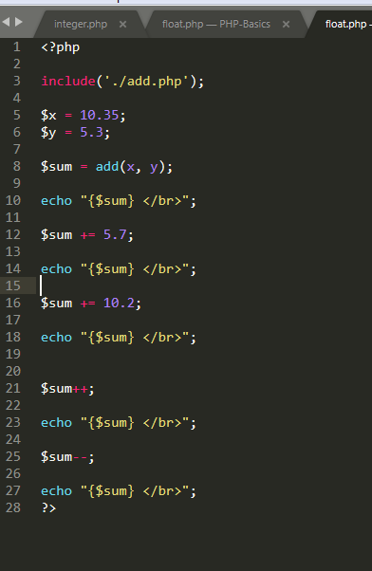
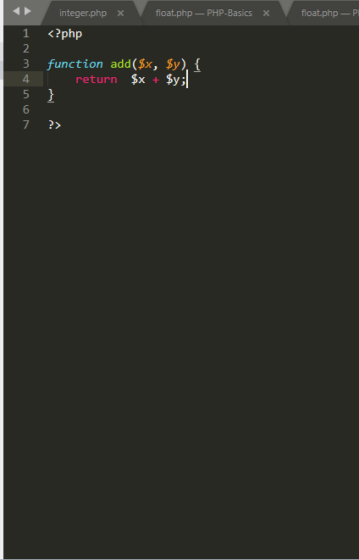
Backend Example

Slide 35
Excercise
For Past Programs regarding computation, please separate those function in different files with different name and include it in your old program.
Float
Local Scoping

Slide 36
Control Loops and Conditional Statements
Control loops: do while, while and for loop
Conditional Statement: if, else if, else

Slide 37
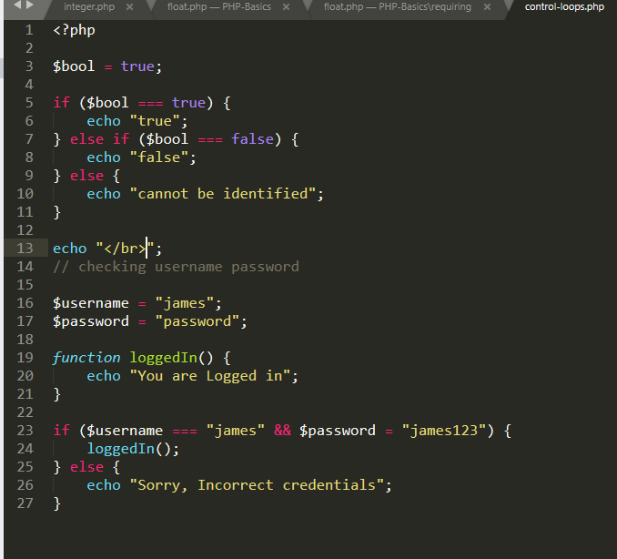
Conditional Statements

Slide 38
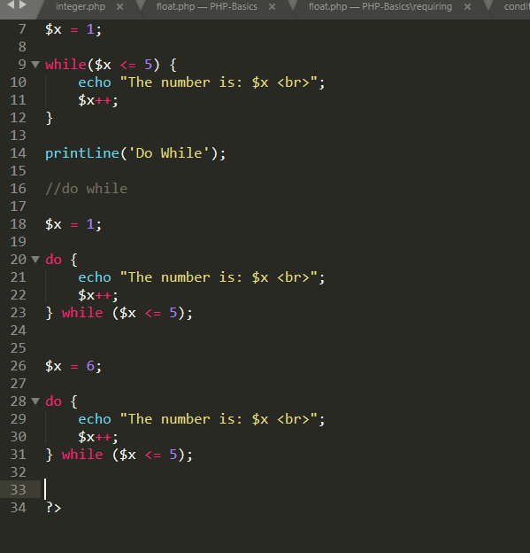
Control Loops: While, Do While

Slide 39
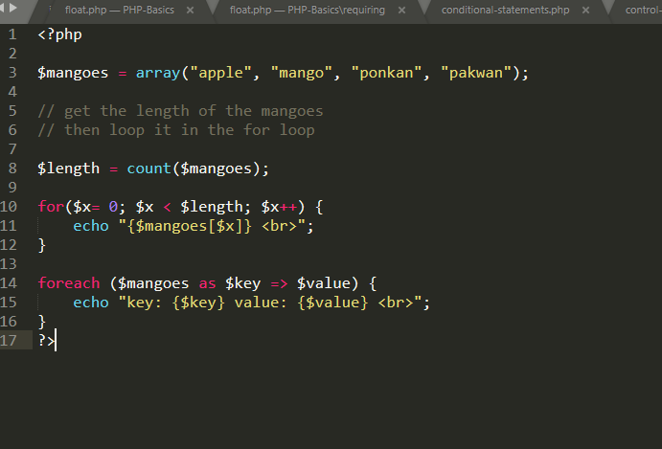
Control Loops: for and foreach

Slide 40
Exercise for control loops and conditional statements
Declare a variable $money = 100
Buy a food = 26
Buy a chicken - 10
Buy a rice – 10
Gulaman - 6
Check if money can buy food then buy else stop the loop, make the money = 0 or use the syntax break;
Use do while, while and for loop in each scenario

Slide 41
Trivia
You can attach function name inside array, can be a key value or value.
You can use Foreach to access multi-dimentional-arrays

